Slide 1
Fireside Cyberchat
Unit 1.3
Cybersecurity Boot Camp |
July 28, 2018

Slide 2
Today’s Theme

Slide 3
Remember Your Why…
“Change my life from better to best”
“Make money doing something I enjoy”
“I’m here because I’m a father and a husband. And we need money”
“Looking to work less and make more”
“I’m an entrepreneur looking to expand solutions for businesses”
“Always had a passion for technology. I’d like to pursue that”
“Learn and gain”
“Work for fun and not money”
“Further my career and get my dream job”
“Secure the financial future for my family”
“New route and new opportunity”
“Gain a new challenge.”
“Bring skills to the world of automation and controls”
“Take the next step by pursuing cybersecurity” “Add to my skillset”

Slide 4
If Only It Were So Easy…

Slide 5

The Security Seeker’s Path
Figuring out how to enter the field of cybersecurity can be daunting and confusing.
Part of the challenge lies in understanding the confines of the industry.
Hire me
please...
Notes:
Review goals; address any questions.

Slide 6

In today’s class we’ll spend time talking about two important topics...

Slide 7
Today’s Topics
Cybersecurity Domains
Notes:
Review goals; address any questions.

Slide 8
Today’s Topics
0 Years
1-2 Years
2-4 Years
4-6 Years
6-10 Years
1
Tech
Enthusiast
Help Desk /
IT Support
Network /
System
Admin
Information
Security
Analyst
Penetration
Testing Lead
Digital
Forensics
Manager
Information
Analyst /
Developer
Systems
Security
Administrator
2
MIS / CS
Degree
Pathway
Cybersecurity
Manager
Business
Consultant
Risk
Analyst
IT Security
Engineer
Application
Security
Consultant
3
Navigating Your Career
Notes:
Review goals; address any questions.

Slide 9
Today’s Goals
By the end of class, you will be able to:
Articulate the major domains that exist in the field of cybersecurity.
List and define common job titles in the cybersecurity field.
Reference advice from cybersecurity professionals on entering, advancing, and selecting your specialty in the cybersecurity field.
Notes:
Review goals; address any questions.

Slide 10
Let’s start with a warm-up.

Slide 11
Quick Review

Slide 12
Quick Review!
Last class we introduced a framework that captures the fundamental goal of information security.
What was the framework?
Notes:
Review goals; address any questions.

Slide 13
Quick Review!
Last class we introduced a framework that captures the fundamental goal of information security.
What was the framework?
The CIA Triad
Notes:
Review goals; address any questions.

Slide 14
Quick Review!
What are the three elements of the
CIA Triad?
Notes:
Review goals; address any questions.

Slide 15
Quick Review!
What are the three elements of the
CIA Triad?
Availability
Integrity
Confidentiality
Notes:
Review goals; address any questions.

Slide 16
Quick Review!
Define each of the three elements in the context of information security:
Confidentiality
Integrity
Availability
Notes:
Review goals; address any questions.

Slide 17
Quick Review!
Define each of the three elements in the context of information security:
Confidentiality:
Ensuring sensitive information is protected from reaches of unauthorized persons.
Integrity:
Protection of information from being modified or tampered by unauthorized persons.
Availability:
Assuring that all operating systems, equipment, and data are functioning correctly and access by those who need it.
Notes:
Review goals; address any questions.

Slide 18
Quick Review!
Provide an example of how each of the three below elements could be adversely affected:
Confidentiality
Integrity
Availability
Notes:
Review goals; address any questions.

Slide 19
Quick Review!
Provide an example of how each of the three below elements could be adversely affected:
Confidentiality:
Banking breach releases credit card info into the public.
Integrity:
Student modifies official grades for himself and his friends.
Availability:
Hackers disable a website through a denial of service attack.
Notes:
Review goals; address any questions.

Slide 20
Quick Review!
Using what you recall from the assignment last class, provide a working definition of each of the following:
Zero Day Attack
Spear Phishing
Infection Vector
Botnet
Lateral Movement Techniques
Honeypot
Notes:
Review goals; address any questions.

Slide 21
Quick Review!
Zero Day Attack: Attack that exploits a previously unknown vulnerability.
Spear Phishing: Email spoofing in which a particular individual or organization is targeted.
Infection Vector: Broad term describing the process by which attackers managed to enter a victim’s network.
Botnet:
Collection of internet connected devices that are infected and controlled by a common type of malware. In this case, each device is controlled a as group.
Lateral Movement Techniques: References the various techniques by which attackers progressively spread through the network in pursuit of assets and data.
Honeypot: Computer system that is setup to act as a decoy to lure cyber attackers and thus detect, deflect, or study their attempts to gain unauthorized access.
Notes:
Review goals; address any questions.

Slide 22
Homework Review: Research Discussions
Last class we introduced a number of threats for you to explore.
What is or was it?
What damage has it done?
What steps have or can be taken to mitigate?
Emotet | Zealot Campaign | Digmine | Triton | BadRabbit
Disakil | Finfisher | Thrip | Orangeworm | Ploutus ATM Malware
Gh0st RAT | Trickbot | Necurs | BlankSlate | CVE-20170199
Vulnerability, Exploits, and Threat Actors
Notes:
Review goals; address any questions.

Slide 23
Cybersecurity Domains

Slide 24

Getting Started in Digital Security
“Providing advice on ‘getting started in digital security is similar to providing advice on “getting started in medicine.”
If you ask a neurosurgeon he or she may propose some sort of experiment with dead frog legs and batteries. If you ask a dermatologist you might get advice on protection from the sun whenever you go outside.
Asking a “security person” will likewise result in many different responses, depending on the individual’s background and tastes.”
Richard Bejtlich, Tao Security https://taosecurity.blogspot.com/2017/03/cybersecurity-domains-mind-map.html
Notes:
Review goals; address any questions.

Slide 25
Cybersecurity Domains
While imperfect Richard Bejtlich (and many others) reference the above map of Cybersecurity Domains as a means of understanding the space.
Notes:
Review goals; address any questions.

Slide 26
Activity: Cybersecurity Domain Exploration (15 mins)
Take a few minutes to explore the Cybersecurity Domain map: https://www.linkedin.com/pulse/map-cybersecurity-domains-version-20-henry-jiang-ciso-cissp/
Create a quick worksheet for yourself with the names and definitions of the major domains (1st nodes).
Take a few minutes to define 4-5 terms or topics that are unclear.
Then take a few minutes to choose the two domains of greatest interest and explore the sub-topics related to it.
Be prepared to share

Slide 27
Cybersecurity Domains Discussed
Security Architecture
Governance
Security Operation
Physical Security
Threat Intelligence
Career Development
Risk Assessment
User Education
Framework and Standards

Slide 28
Cybersecurity Careers

Slide 29
Activity: Finding a Job in Security… Blindly (5 Min)
Take a few minutes to search popular job listing websites (Indeed, LinkedIn, Dice) for “Cybersecurity Jobs”.
Be prepared to share:
What search terms did you use?
How many jobs did you find?
What did the job descriptions entail?
What skills / qualifications did you see frequently?

Slide 30
Sample (Entry Level) Cybersecurity Titles
Security Analyst | Security Operations Center (SOC) Analyst | Security Engineer | Systems Engineer
Cyber Threat Analyst | Cyber Defense Analyst | Incident Response Analyst | Intelligence Analyst
Information Assurance Technician | Risk Analyst | Forensics Investigator | Systems Administrator
Network Engineer | IT Auditor | Application Security Engineer | Penetration Tester
Information Analyst | Systems Security Analyst | IT Specialist | Web Engineer – Application Security
Knowing the correct job titles and job types is the first step towards pursuing a career in the space. Be precise in your search!

Slide 31
Activity: Finding a Job in Security… Clearly (10 Min)
Select any three of the job titles shown on the previous slide and repeat the job search exercise.
Be prepared to share:
What search terms did you use?
How many jobs did you find?
What did the job descriptions entail?
What skills / qualifications did you see frequently?
Is there anything surprising that stands out to you?

Slide 32
Career Context (The Demand)
According to a report from Frost and Sullivan and (ISC)² there will be more than 1.5 million unfilled cybersecurity positions by 2020.
A similar report conducted by ISACA found:
53% of organizations experience delays as long as 6 months to find qualified cybersecurity candidates.
Cybersecurity jobs grew at a rate 3x as fast as IT jobs as a whole between 2010-2014.
84% of organizations believe half or fewer of its applicants for open security jobs are qualified.

Slide 33
Career Context (The Reality)
According to (ISC)², a full 87% of all cybersecurity professionals started their careers doing something different.

Slide 34
Career Context (Desired Skills)
Core knowledge of topics like Networking, TCP/IP, OSP layers, and encryption provide a common language around theory and fundamentals.
Certifications like Network+, Security+, CEH, and CISSP establish a baseline level of competency and are seen as a rite-of-passage for many jobs.
“Tickets”
Certifications
“Tenets”
Core Knowledge
“Tools”
Applied Skills
Proficiency with modern tools like Wireshark, Kali Linux, basic programming, and Metasploit ultimately drive a professional towards being a practitioner in the field.

Slide 35
Career Context (Common Pathways)
0 Years
1-2 Years
2-4 Years
4-6 Years
6-10 Years
1
Tech
Enthusiast
Help Desk /
IT Support
Network /
System
Admin
Information
Security
Analyst
Penetration
Testing Lead
Digital
Forensics
Manager
Information
Analyst /
Developer
Systems
Security
Administrator
2
MIS / CS
Degree
Pathway
Cybersecurity
Manager
Business
Consultant
Risk
Analyst
IT Security
Engineer
Application
Security
Consultant
3
While it’s possible to leap frog between steps a bit, to some degree the cybersecurity industry is looking for proven experience in hiring. If you’re new to the field, you may have to take lumps to get your foot in the door. Remember: This is a career you are building.

Slide 36
Fireside Chat

Slide 37
For the next hour, we’ll be having a fireside chat with our Instructors and TAs to hear their career stories, get their perspectives on industry, and tips for breaking into the field.

Slide 38
Preview of Next Week

Slide 39
Fair Warning: Right off the bat, over the next two weeks we’ll be ratcheting up the challenge level in this class. If you are unfamiliar with the command line or programming – be prepared to put in some sweat.
Time to skill up!

Slide 40
Don’t worry. It will be fun!

Slide 41
Lunch / Homework Time

Slide 42
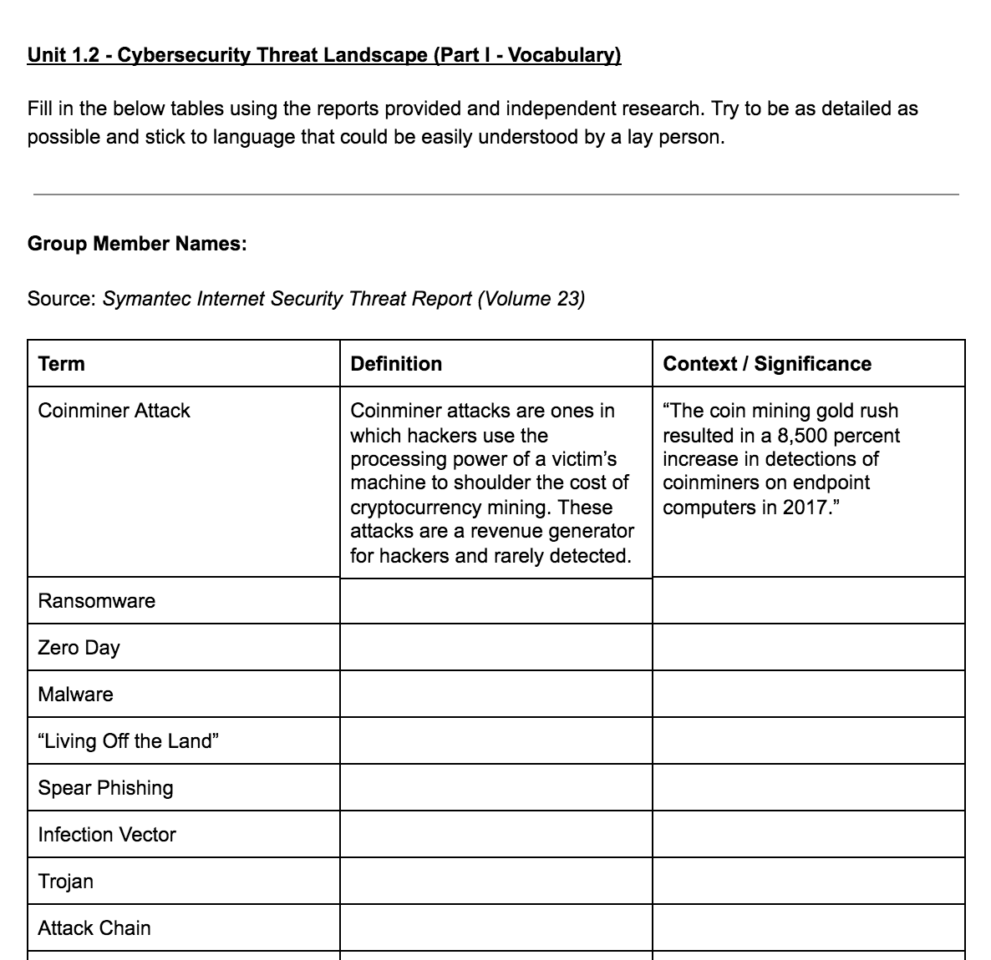
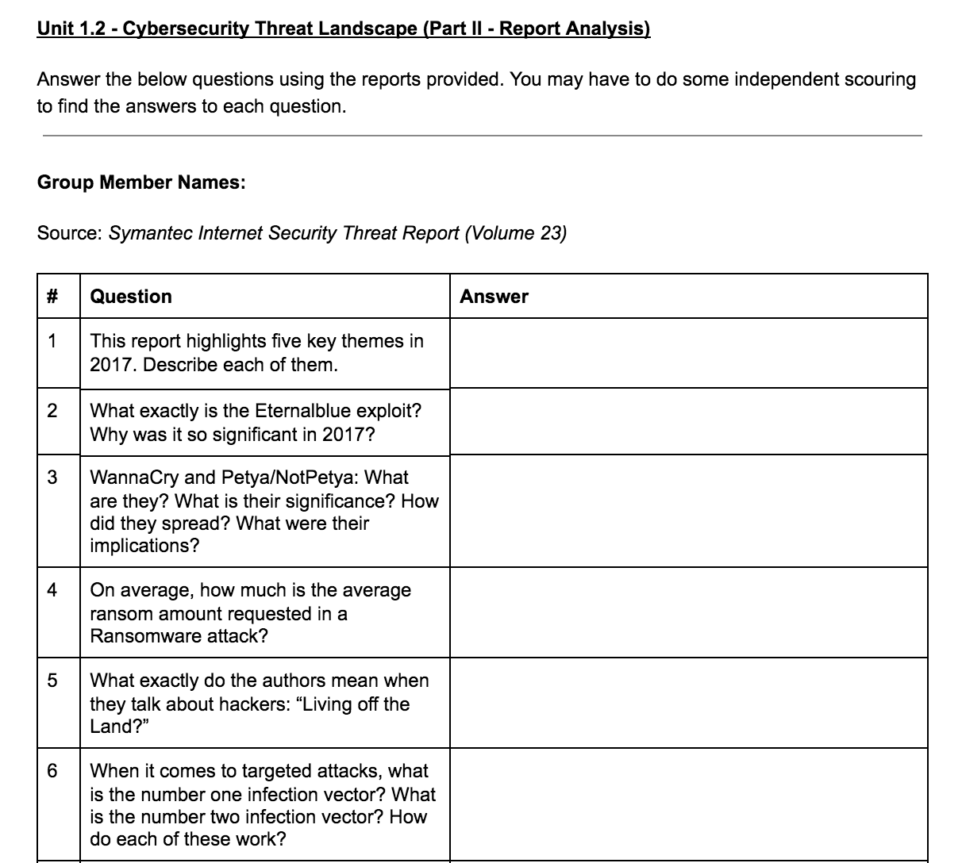
Remember Week 1 Homework is due this Tuesday (7/31) at the start of class.
We’ll be here today after lunch and during office hours to help.

Slide 43
Discussions / Questions

